Slide 1

Donation Management System
KINDNESS CORNER

Slide 2

Smt. Tanuben & Dr. Manubhai Trivedi College Of Information Science Surat(B.C.A Self Financed)
Project On :Donation Management System
GUIDE BY :
Prof. Mrs. Bhautika R. Patel
Submitted By.
Roshni S. Mali - 7800

Slide 3
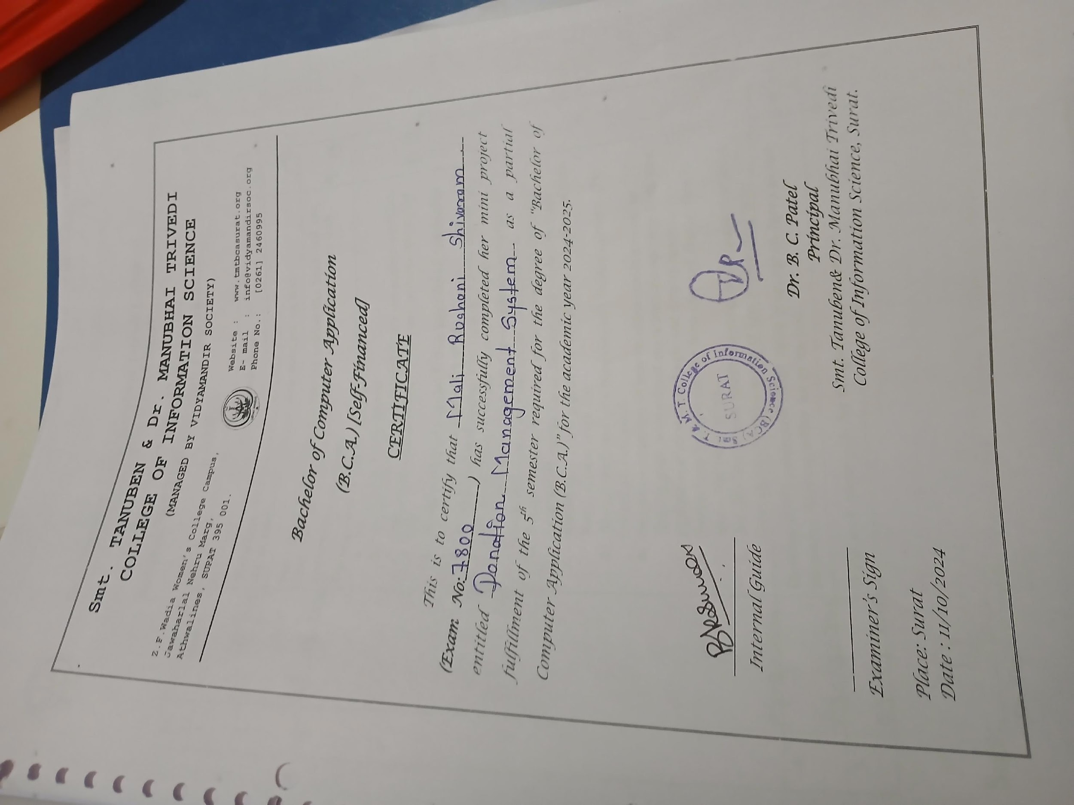

Slide 4
Content
Project introduction
Scope and objective of project
Tools and technologies used
UML (USECASE)
Modules and its Functionalities
Table Structure
Screenshots

Slide 5
1. Project Introduction
Welcome to Donation Management System Website
Our Vision: To create a supportive community where every donation, big or small, contributes to significant change.

Slide 6
2. What We Offer :
A platform to discover and support
various donation-related Money and other things.
Transparency in how donations are utilized, ensuring every contribution makes a difference.
Updates and success stories from the projects you support.

Slide 7
3. Scope And Objectives of Project
1. Streamline Donations
2. Increase Accessibility
3. Enhance Transparency
4. Foster Community Engagement
5. Support a Variety of Causes
6. Boost Fundraising Efforts
7. Encourage Recurring Donations
8. Provide Educational Resources
9. Ensure Security and Trust
10. Measure and Report Impact

Slide 8
4. Tools And Technologies Used
Client-Side Requirements
Front End Tools
Edge
Google Chrome

Slide 9
Server-side Requirements
4. Tools And Technologies Used
Operating System | Windows
Front End Tools | HTML, CSS, Bootstrap ,Google Chrome ,javaScript ,jQuery ,AJAX
Back End Tools | PHP
Editor | VS Code
Database | MySQL

Slide 10




4. Tools And Technologies Used

Slide 11




4. Tools And Technologies Used

Slide 12
5. UML (USECASE)

Slide 13
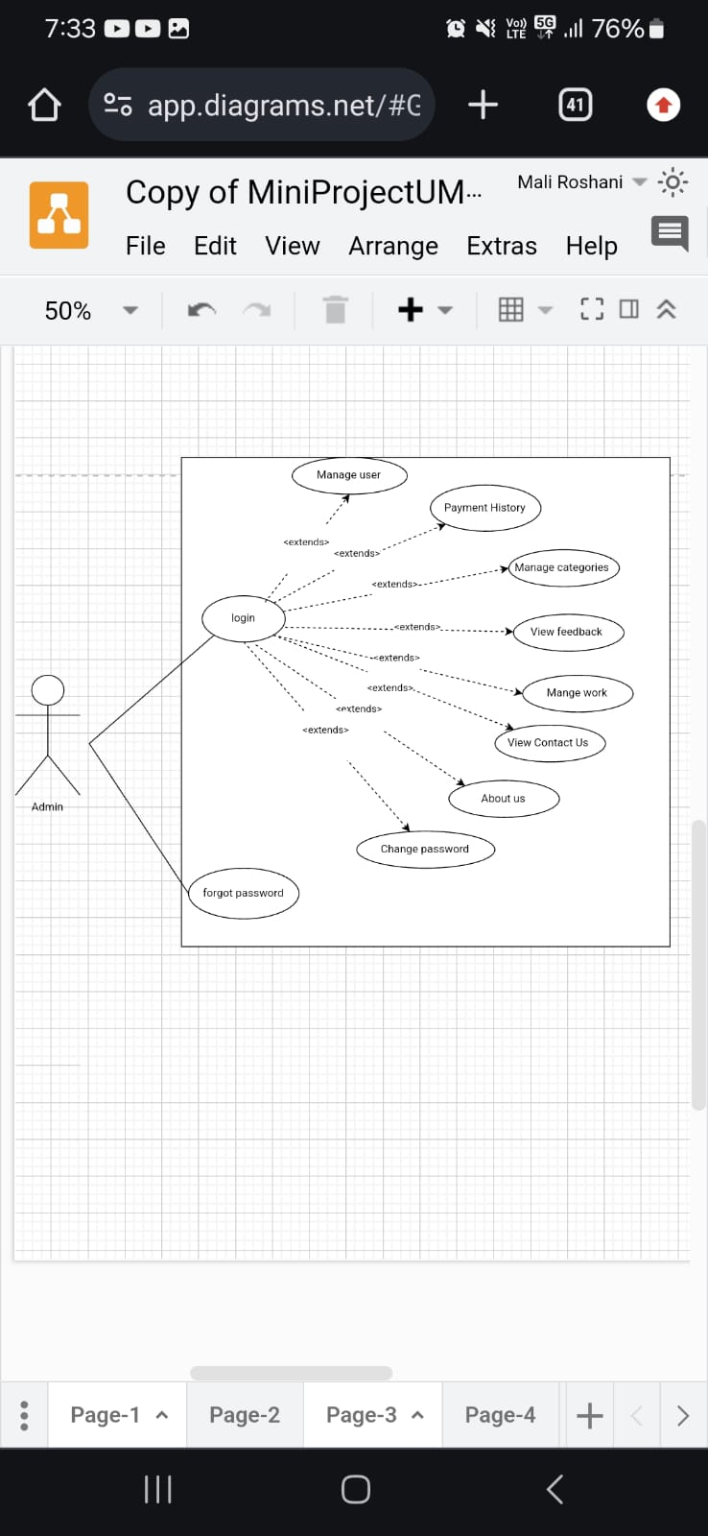
5. UML (USECASE) Admin

Slide 14
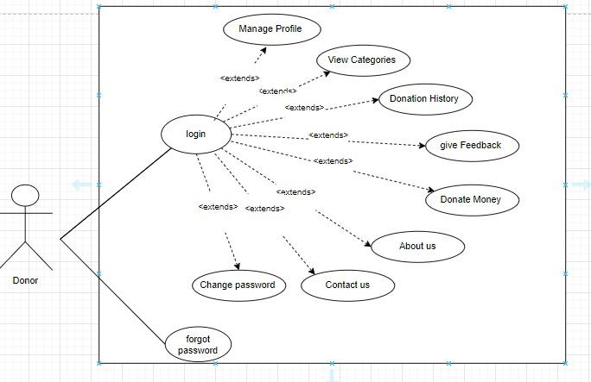
5. UML (USECASE) Donor

Slide 15
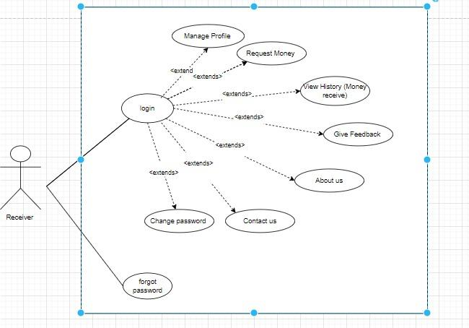
5. UML (USECASE) Receiver

Slide 16
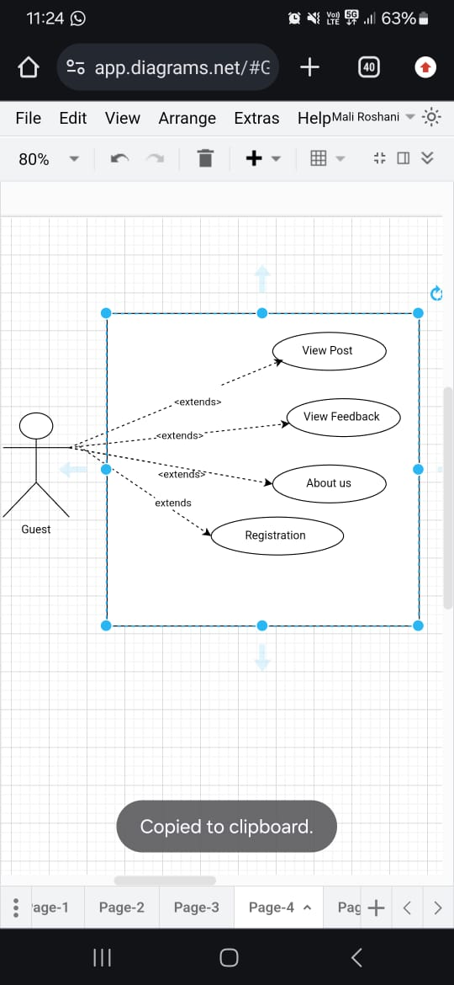
5. UML (USECASE) Guest

Slide 17
6. Modules and its Functionalities
ADMIN
Login
Manage user
Payment history
Manage categories
View feedback
Manage work
About Us
Contact Us
Change Password
Forgot Password
Logout

Slide 18
6. Modules and its Functionalities
DONOR
Login
Manage profile
View categories
Donation history
Give feedback
Donate money
About us
Contact us
Change Password
Forgot Password
Logout

Slide 19
6. Modules and its Functionalities
RECEIVER
Login
Manage Profile
Request Money
View History(money receive history)
Give Feedback
About us
Contact us
Change Password
Forgot Password
Logout

Slide 20
6. Modules and its Functionalities
GUEST
Home
View Post
View feedback
About us
Registration

Slide 21
7. Table Structure
Admin Table
Donor Table
Receiver Table
Category Table
Work Table
Donation Table
Request Table
Feedback Table
Contact Us Table

Slide 22
Admin Table
Column Name | Data Type
Admin_Id | int
Admin_Name | varchar(50)
Email | varchar(50)
Password | varchar(50)
Create_Date | timestamp
Phone_No | Varchar(10)
Image | Varchar(100)
Security_Question | Varchar(50)
Security_Answer | Varchar(50)

Slide 23
Donor Table
Column Name | Data Type
Donor_Id | int
Donor_Name | varchar(50)
Email | varchar(50)
Password | varchar(50)
Create_Date | timestamp
Phone_No | Varchar(10)
Bank_Name | Varchar(50)
Bank_IFSC_Code | Varchar(12)
Security_Question | Varchar(50)
Security_Answers | Varchar(50)

Slide 24
Receiver Table
Column Name | Data Type
Receiver_Id | int
Receiver_Name | varchar(50)
Email | varchar(50)
Password | varchar(50)
Create_Date | timestamp
Phone_No | Varchar(10)
Image | Varchar(100)
Bank_Name | Varchar(50)
Bank_IFSC_Code | Varchar(12)
Security_Question | Varchar(50)
Security_Answers | Varchar(50)

Slide 25
Category Table
Column Name | Data Type
Category_Id | int
Category_Name | varchar(50)
Description | varchar(100)
Image | varchar(50)

Slide 26
Work Table
Column Name | Data Type
Work_Id | int
TItle | Varchar(50)
Description | Varchar(100)
Image | Varchar(100)
Amount | Int(10)

Slide 27
Donation Table
Column Name | Data Type
Donation_Id | int
Donor_Id | int
Reciever_Id | Int
Category_Id | Int
Description | varchar(100)
Payment_Type | Varchar(20)
Bank_Name | Varchar(50)
Bank_IFSC_Code | Varchar(12)
Payment_Amount | Int(10)
Donation_Date | timestamp
Status | Varchar(20)

Slide 28
Request Table
Column Name | Data Type
Request_Id | int
Receiver_Id | int
Category_Id | int
Description | Varchar(50)
Bank_Name | Varchar(50)
Bank_IFSC_Code | Varchar(12)
Payment_Amount | Int(10)
Request_Date | timestamp

Slide 29
Feedback Table
Column Name | Data Type
Feedback_Id | int
Donor_Id | int
Receiver_Id | int
Rating | Int(1)
Comments | Varchar(100)
Feedback_Date | timestamp

Slide 30
Contact Us Table
Column Name | Data Type
Contact_Id | int
Admin_id | int
Donor_Id | int
Receiver_Id | Int
Date | timestamp

Slide 31
8. Screenshots
Guest

Slide 32
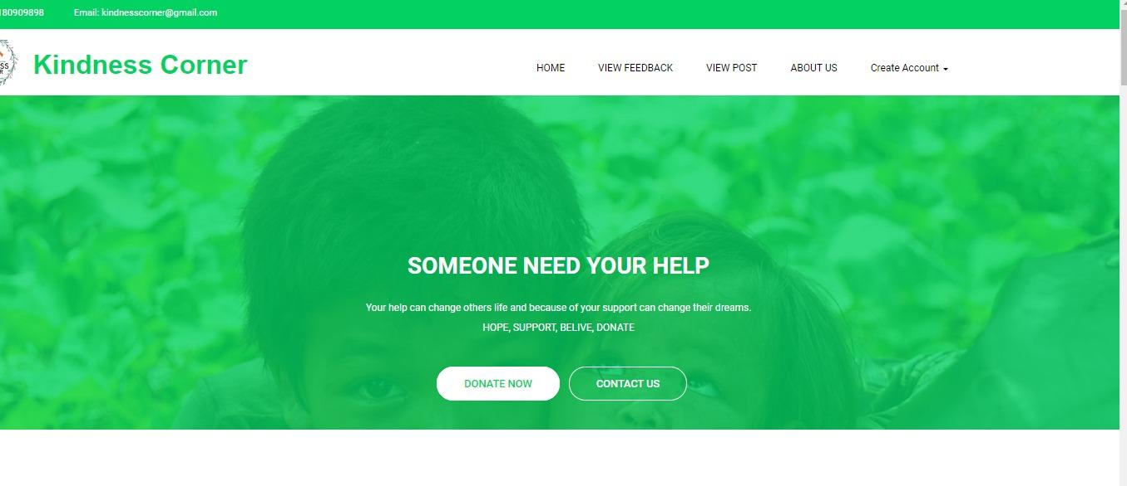
1. Home

Slide 33
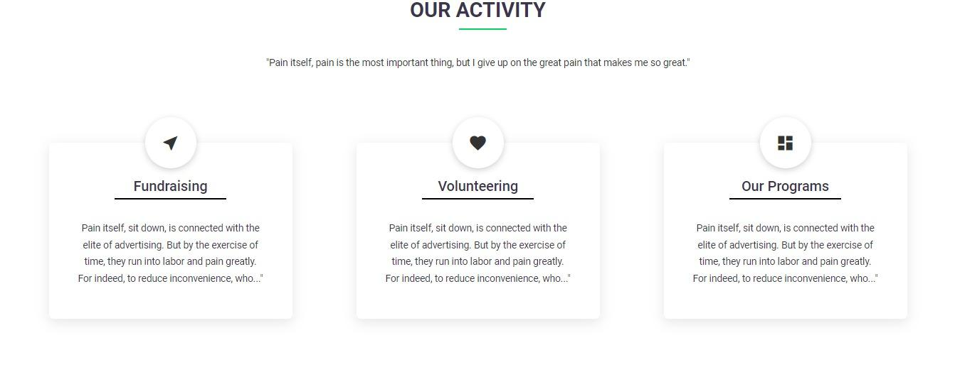
1. Home

Slide 34
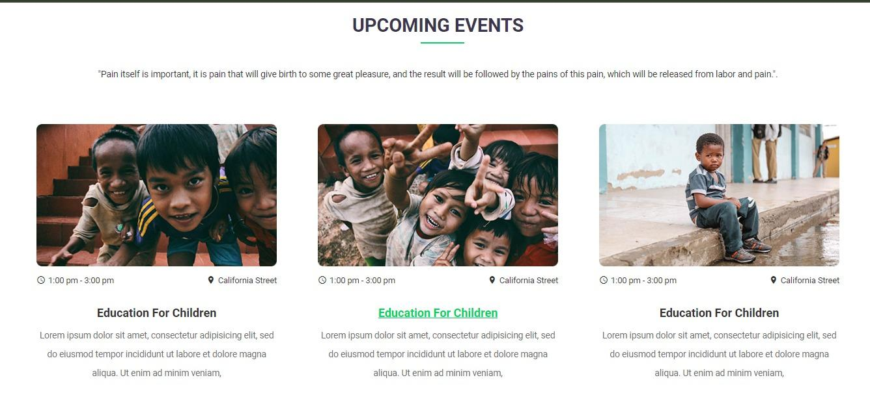
1. Home

Slide 35
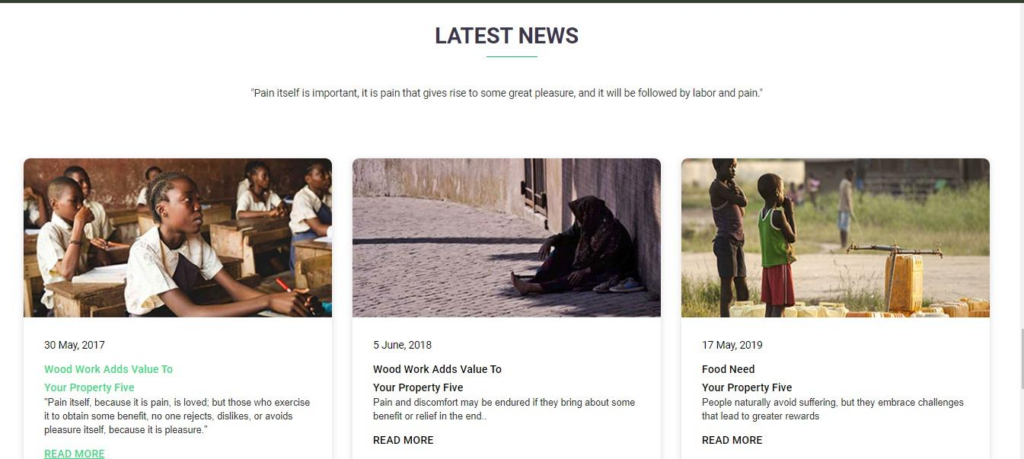
1. Home

Slide 36
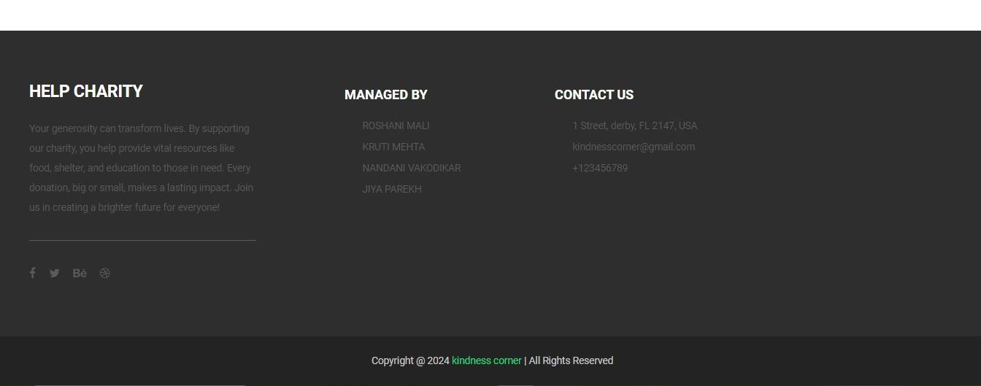
1. Home

Slide 37
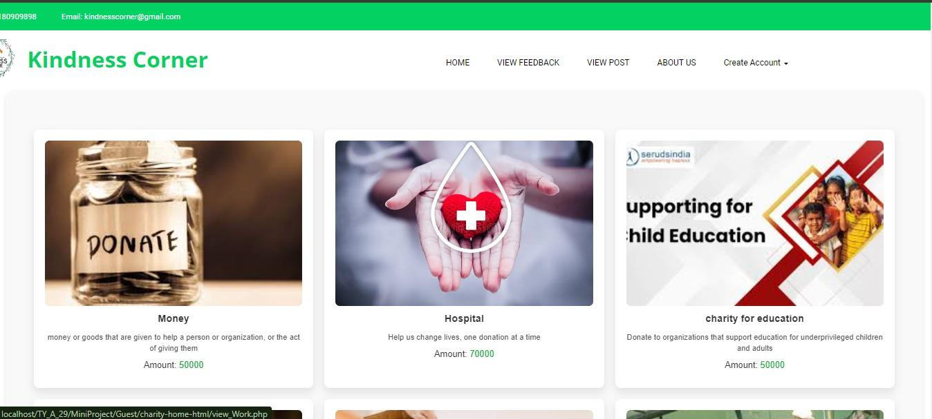
2. View Post

Slide 38
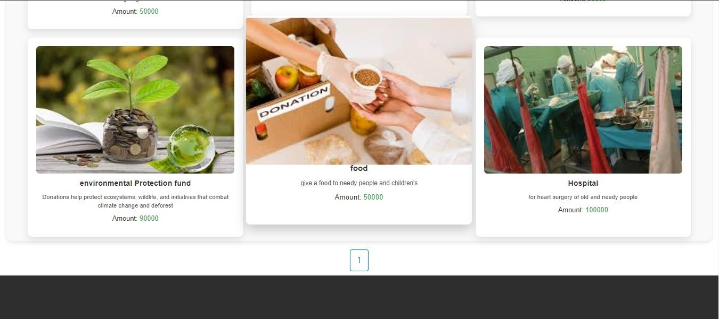
2. View Post

Slide 39
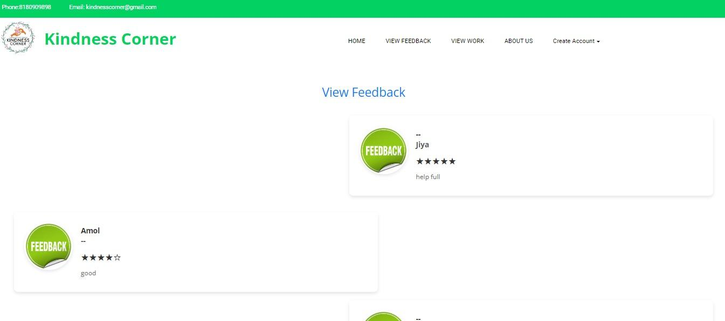
3. View feedback

Slide 40
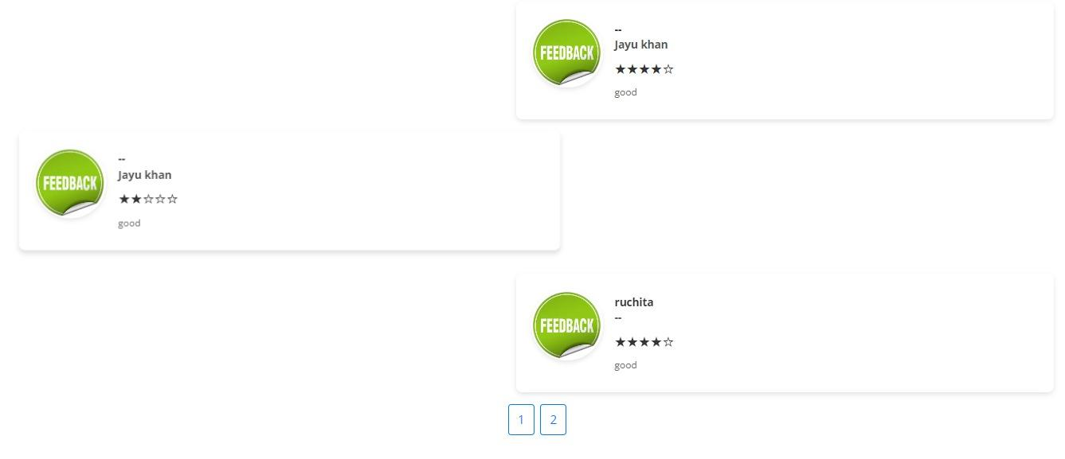
3. View feedback

Slide 41
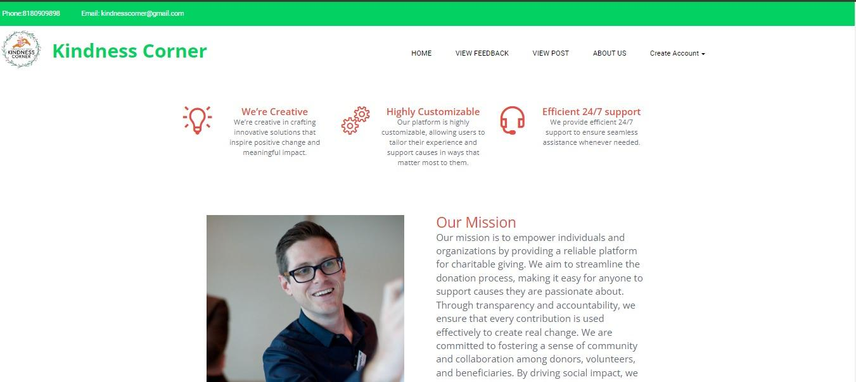
4. About us

Slide 42
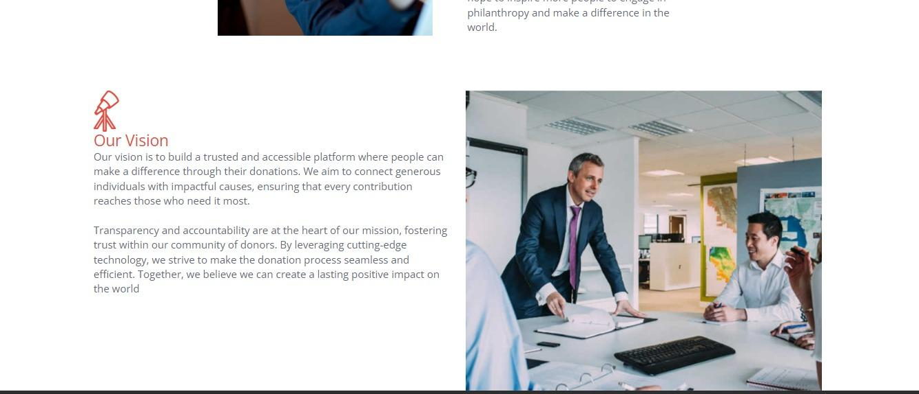
4. About us

Slide 43
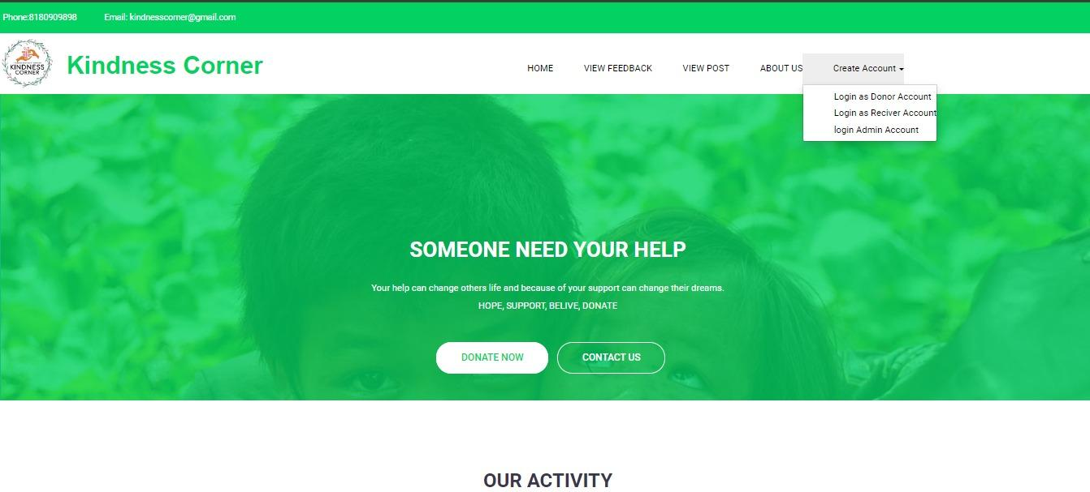
5. Registration

Slide 44
8. Screenshots
Admin

Slide 45
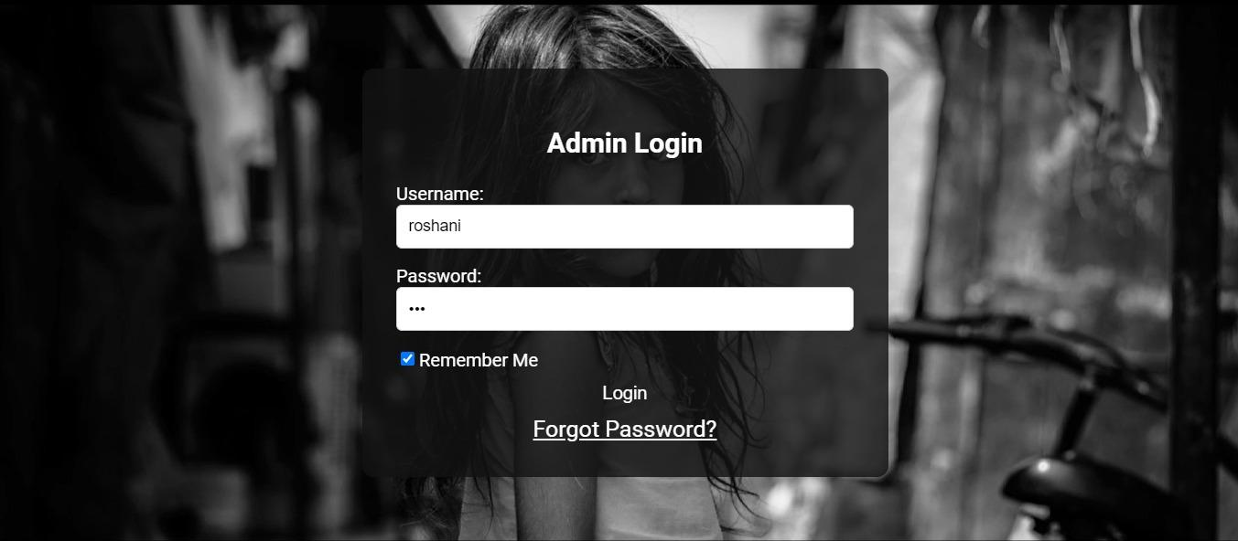
1. Login

Slide 46
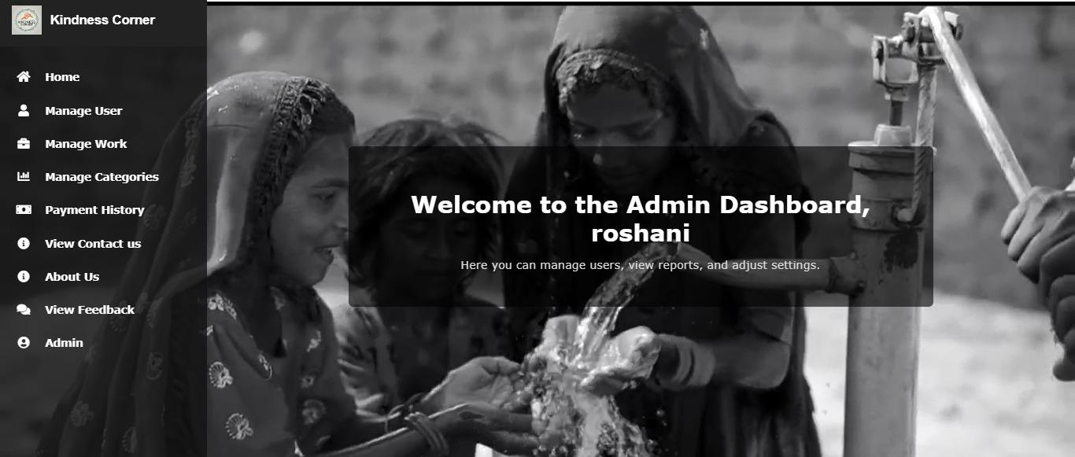
Home

Slide 47
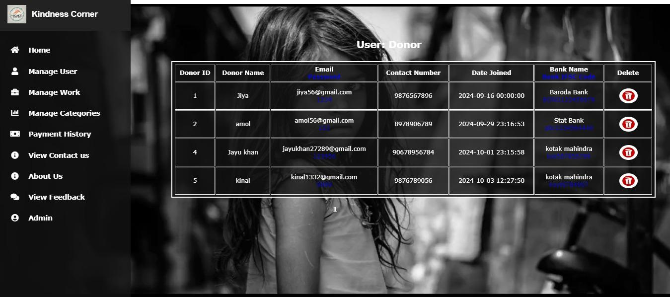
2. Manage user(donor)

Slide 48
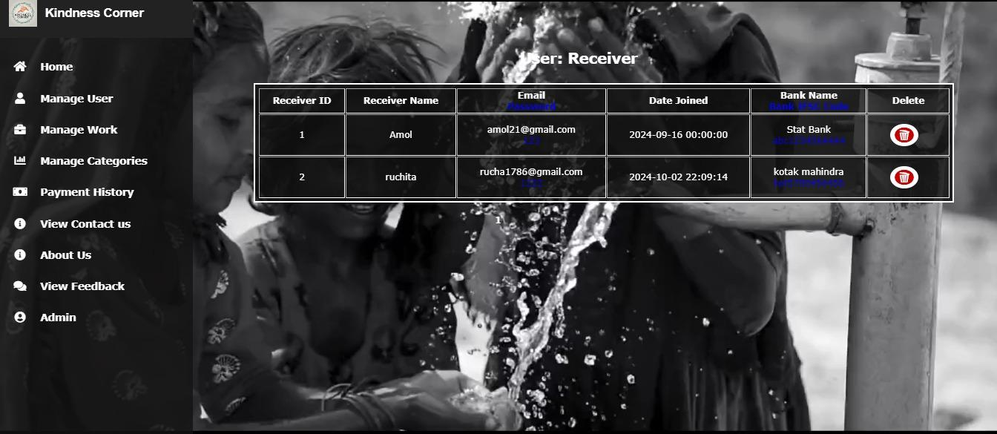
3. Manage user(receiver)

Slide 49
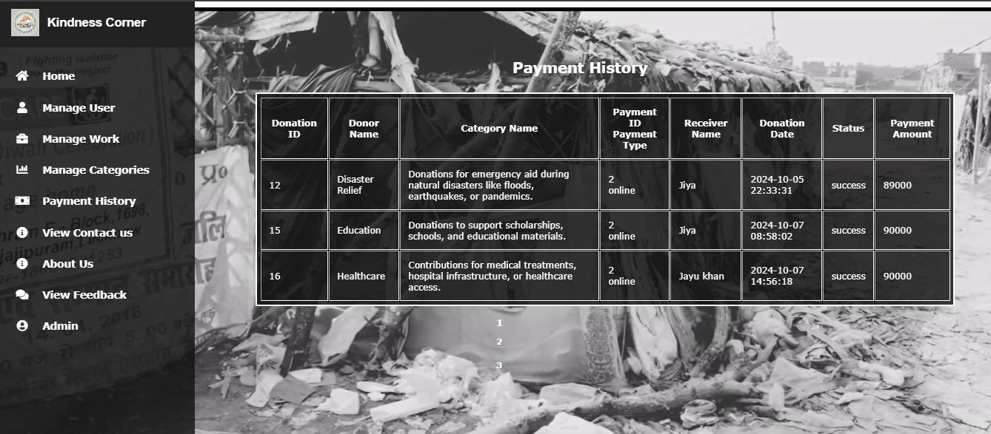
4. Payment history (Donor)

Slide 50
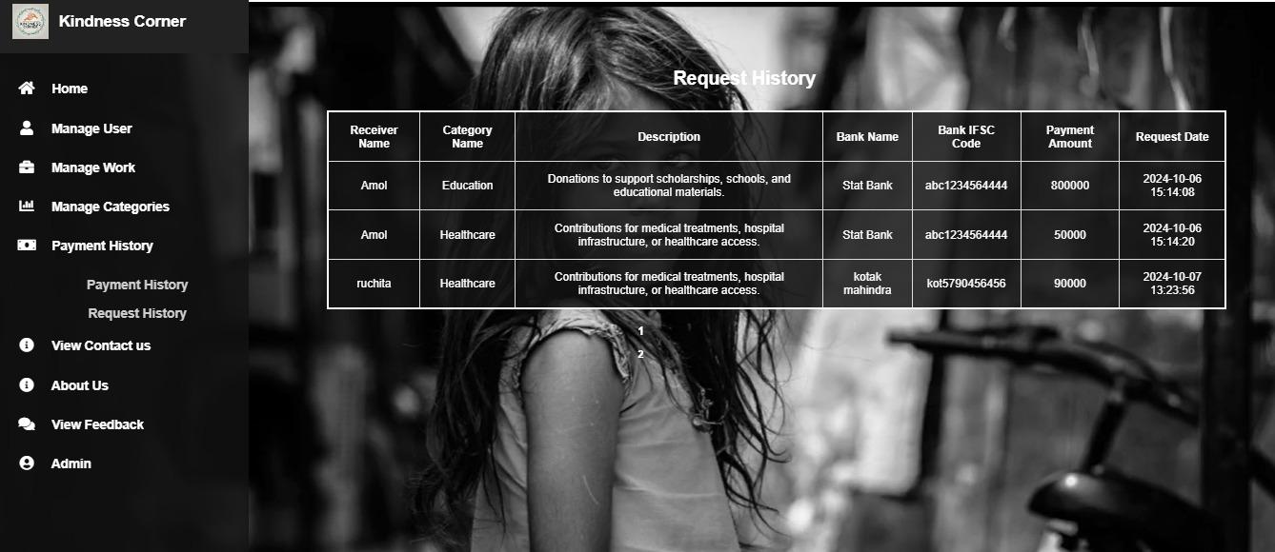
5. Request history (receiver)

Slide 51
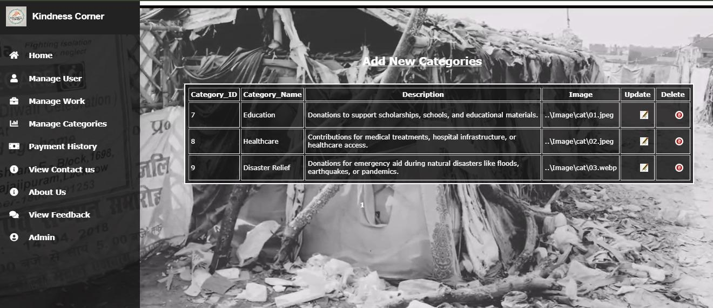
6. Manage categories (view all)

Slide 52
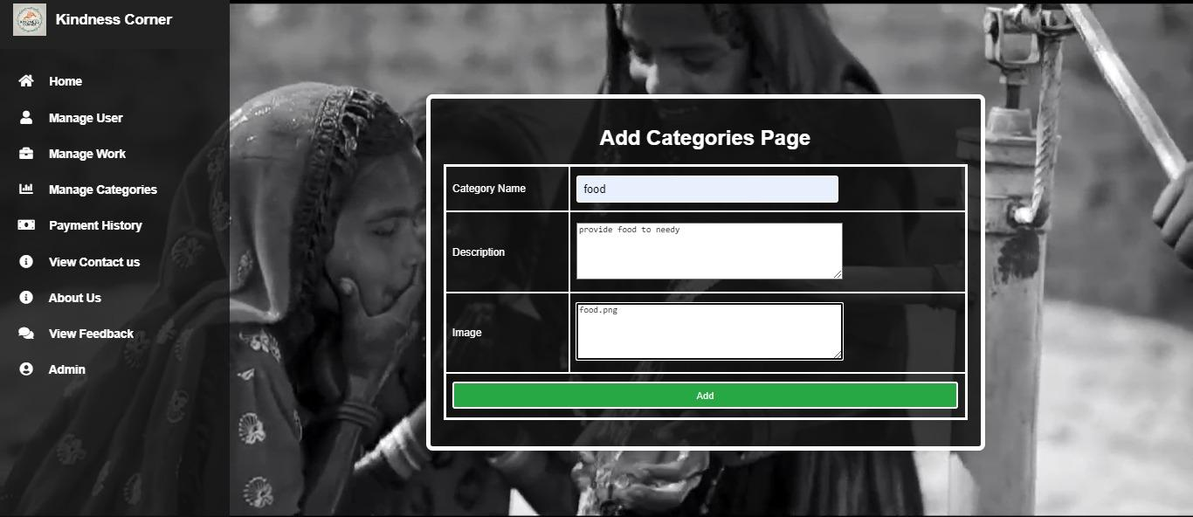
7. Manage categories (add)

Slide 53
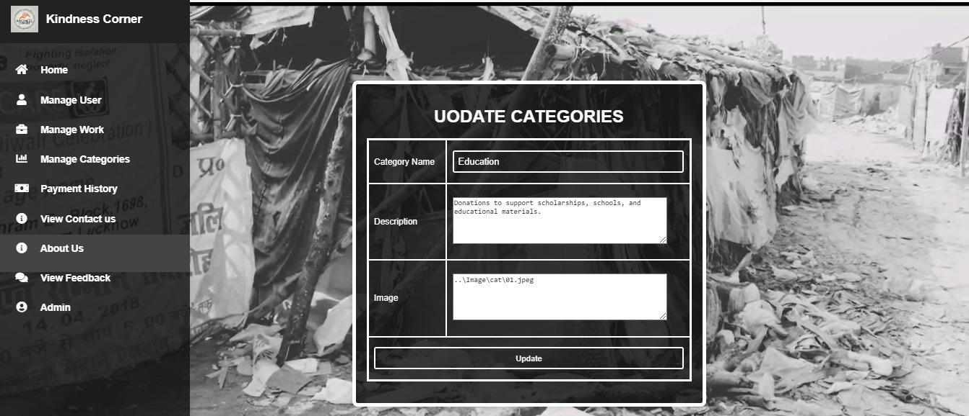
8. Manage categories (update)

Slide 54
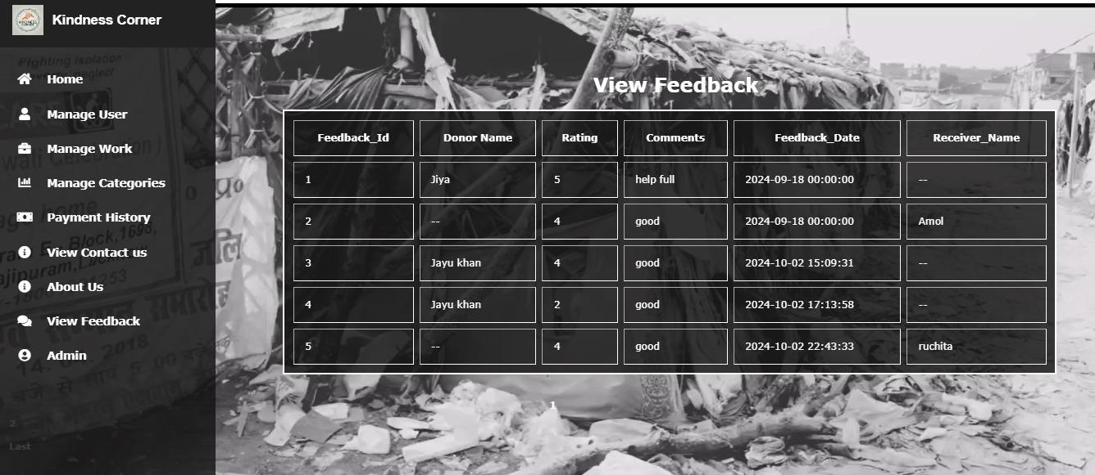
9. View feedback

Slide 55
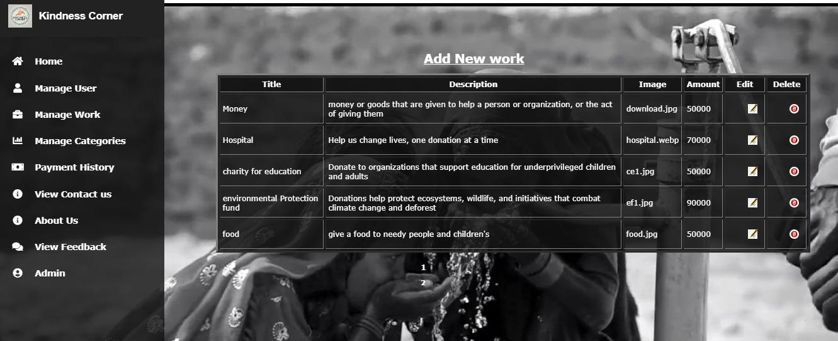
10. Manage work(view)

Slide 56
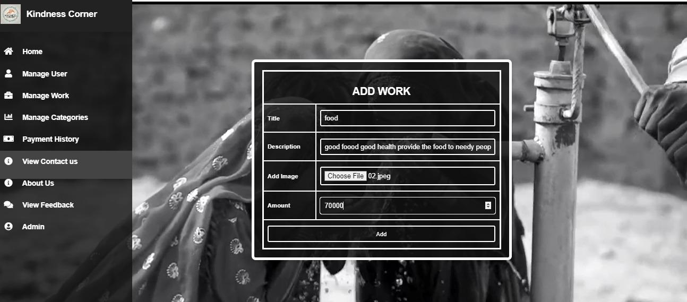
11. Manage work(Add)

Slide 57
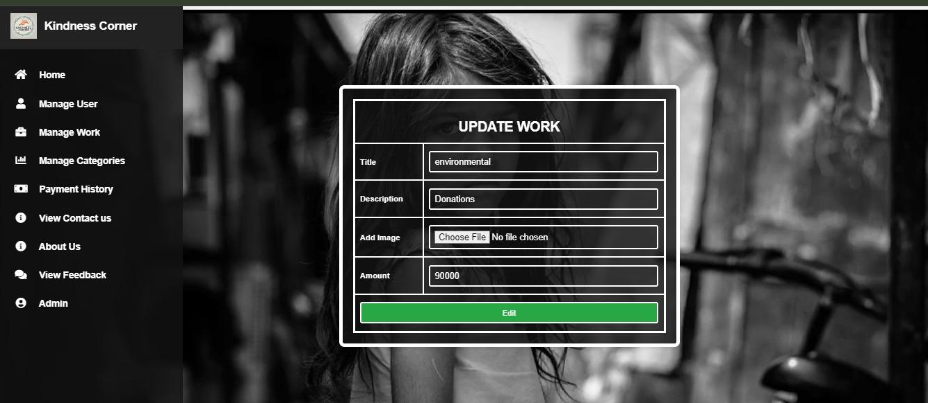
12. Manage work(Edit)

Slide 58
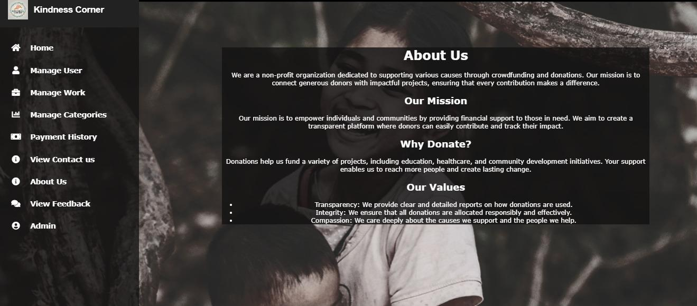
13. About Us

Slide 59
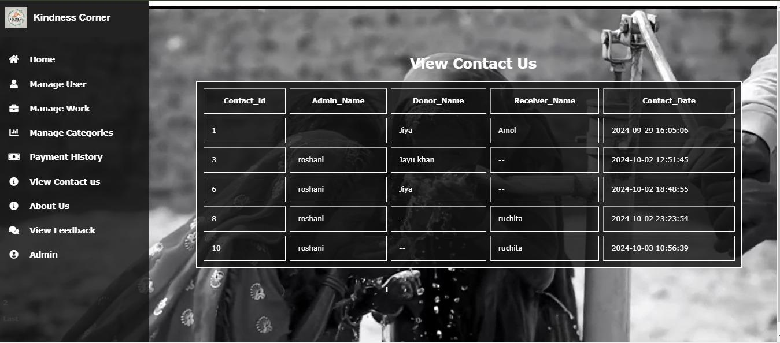
14. Contact Us

Slide 60
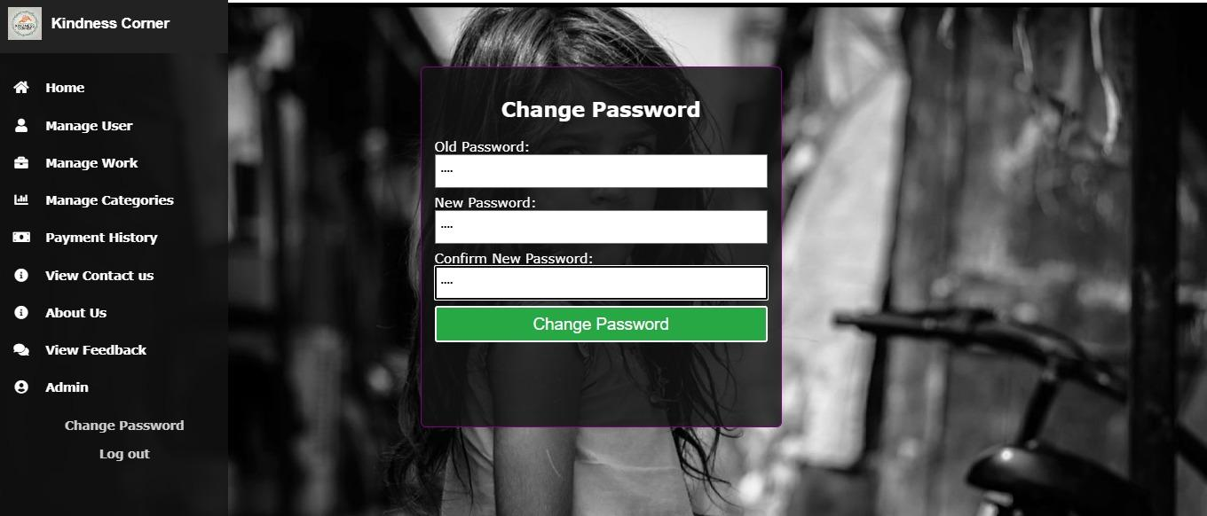
15. Change Password

Slide 61
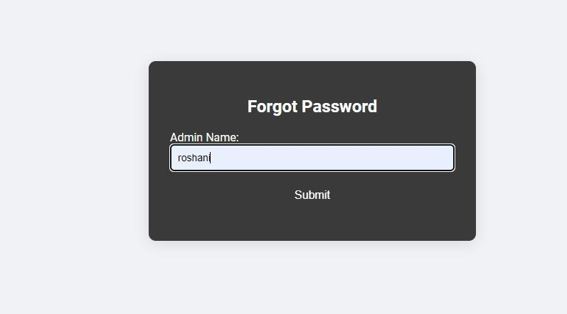
16. Forgot Password

Slide 62
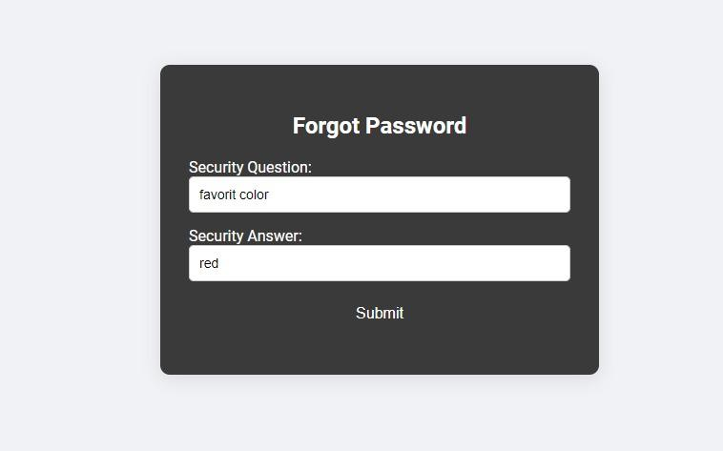
16. Forgot Password

Slide 63
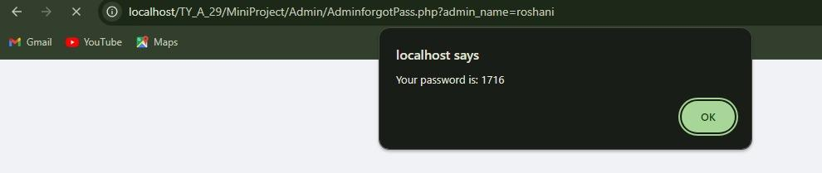
16. Forgot Password

Slide 64
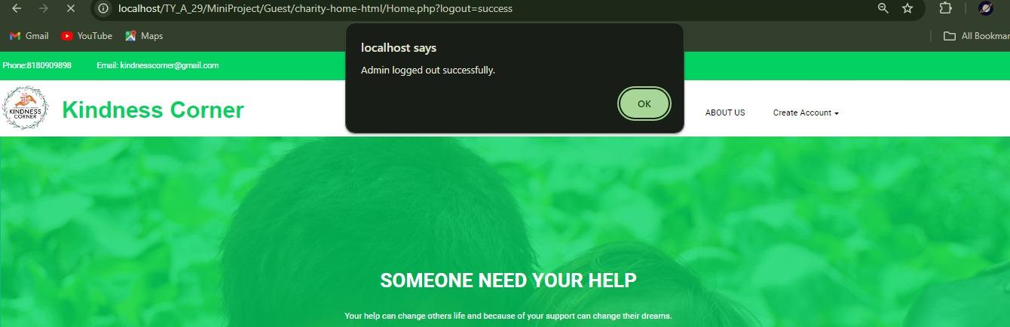
17. Logout

Slide 65
8. Screenshots
Donor

Slide 66
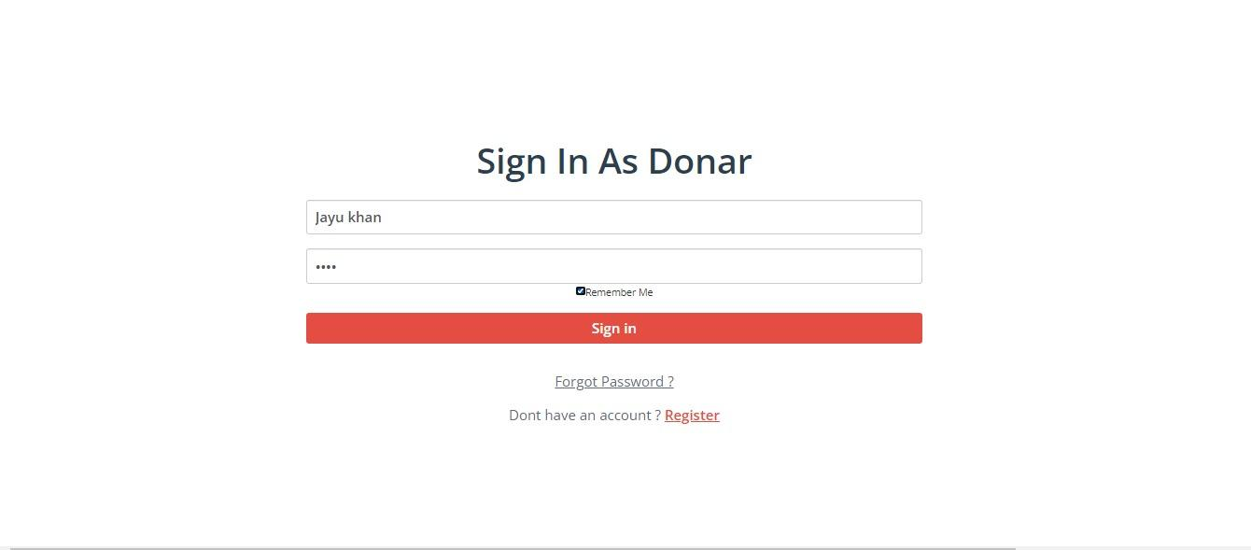
1. Login

Slide 67
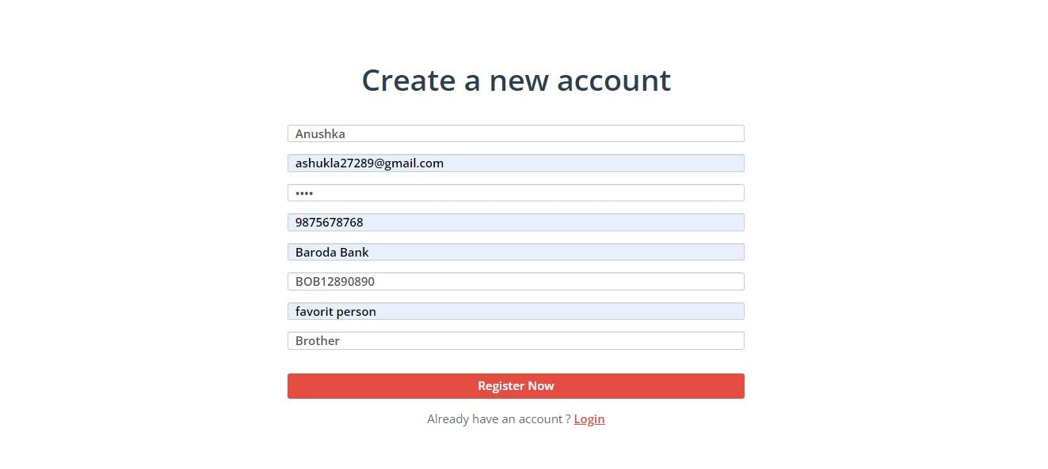
2. Sign Up

Slide 68
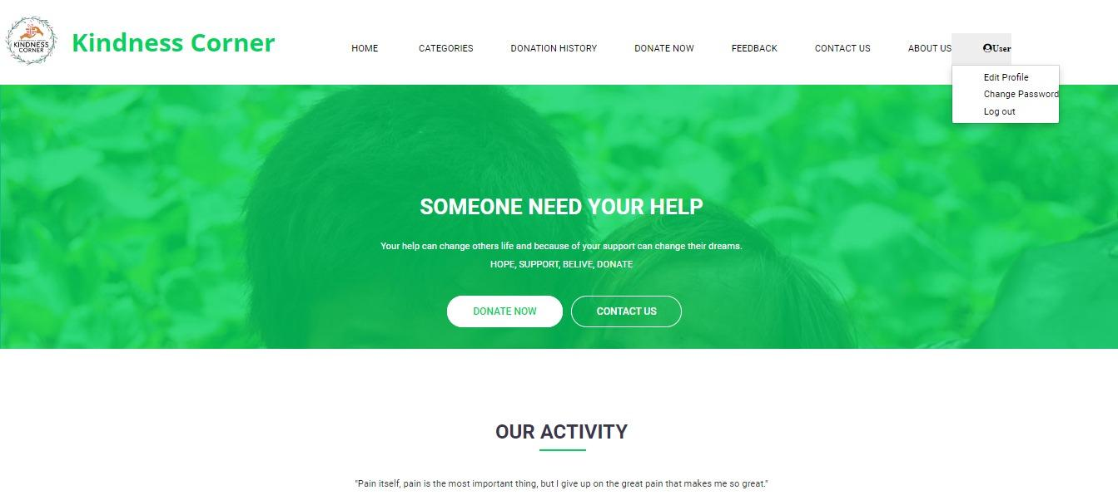
3. Manage profile (Edit)

Slide 69
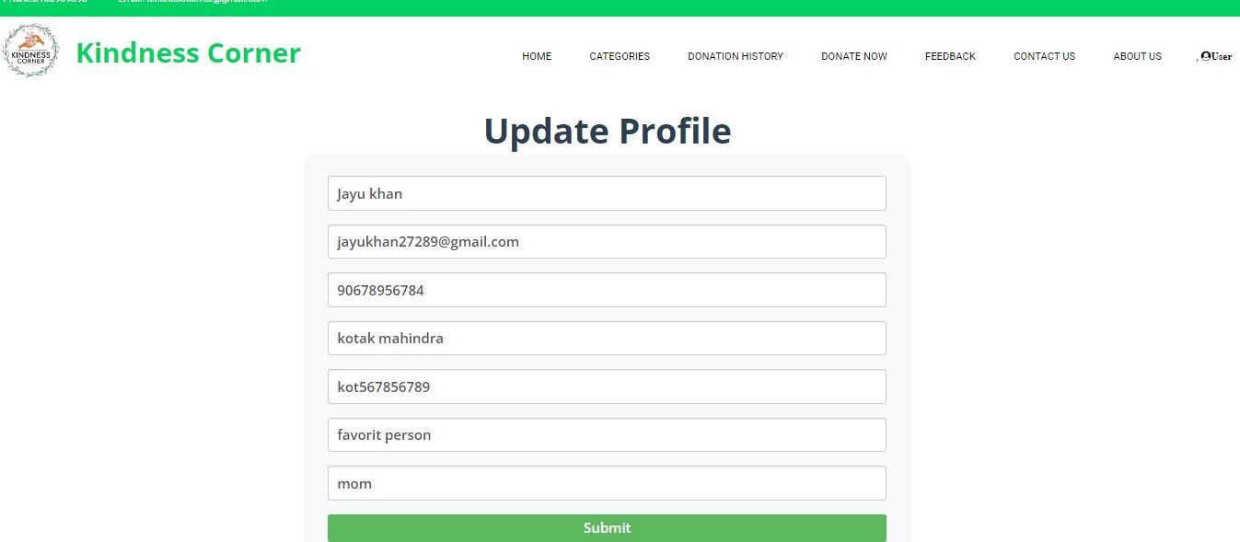
3. Manage profile (Edit)

Slide 70
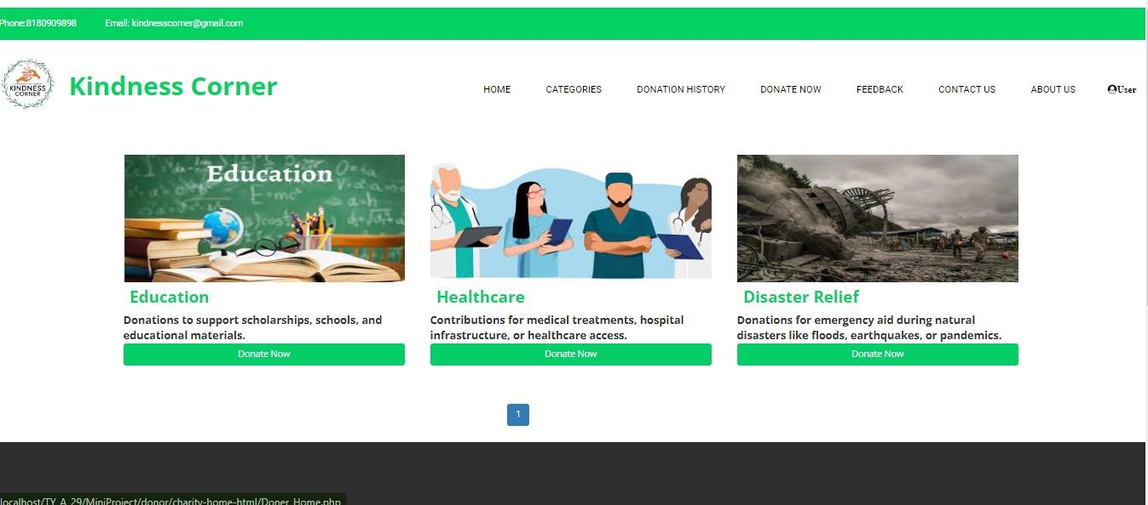
4. View categories

Slide 71
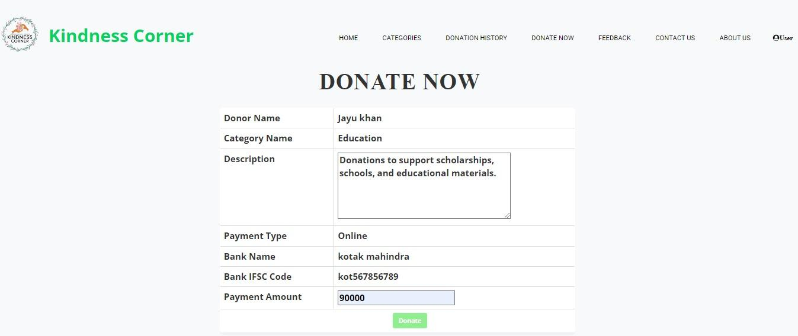
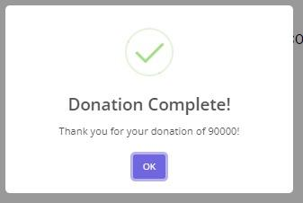
5. Add Donate Money

Slide 72
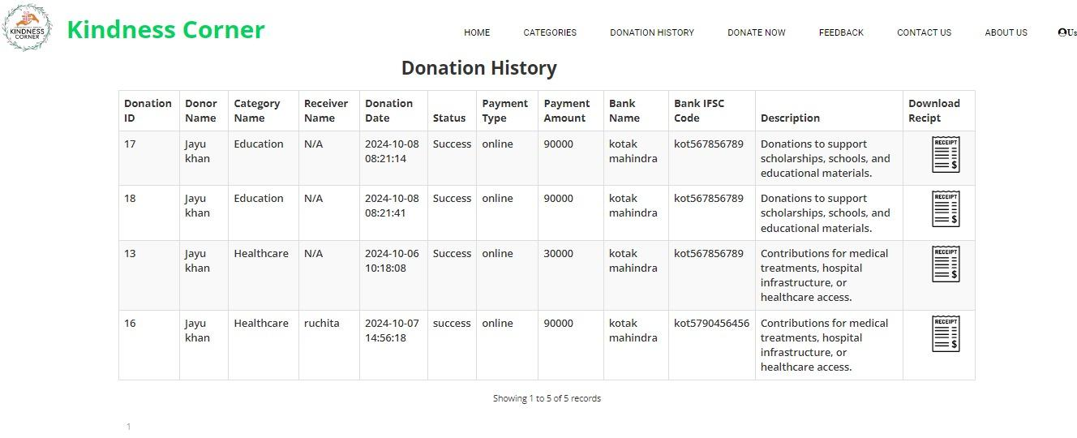
6. Donation history

Slide 73
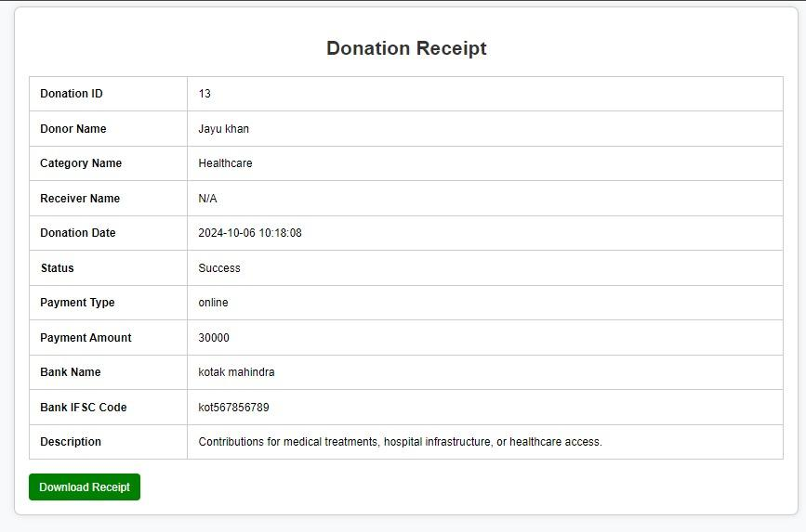
7. Donation money receipt

Slide 74
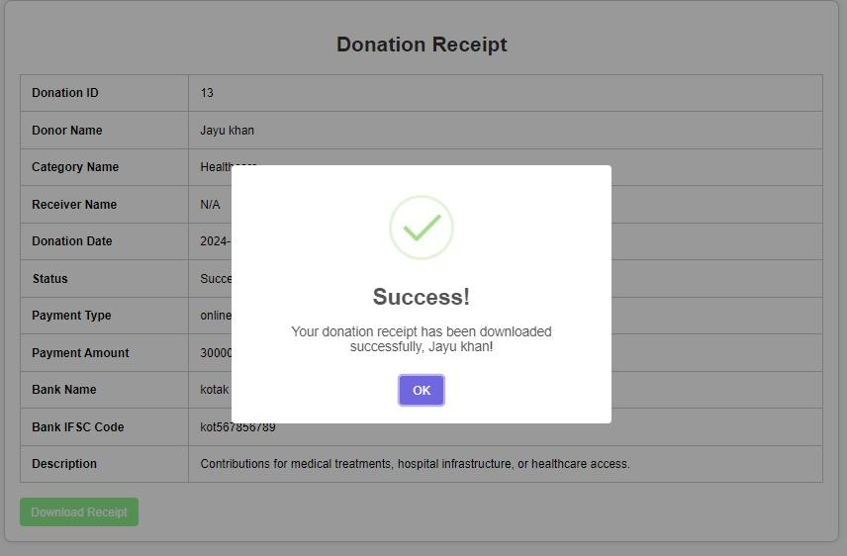
7. Donation money receipt

Slide 75
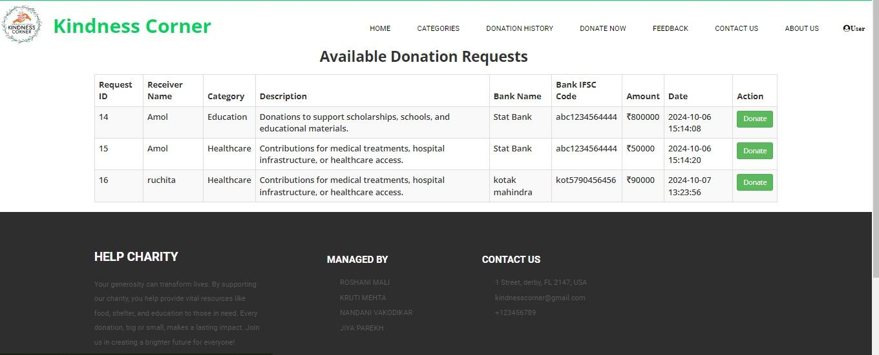
8. Donation money

Slide 76
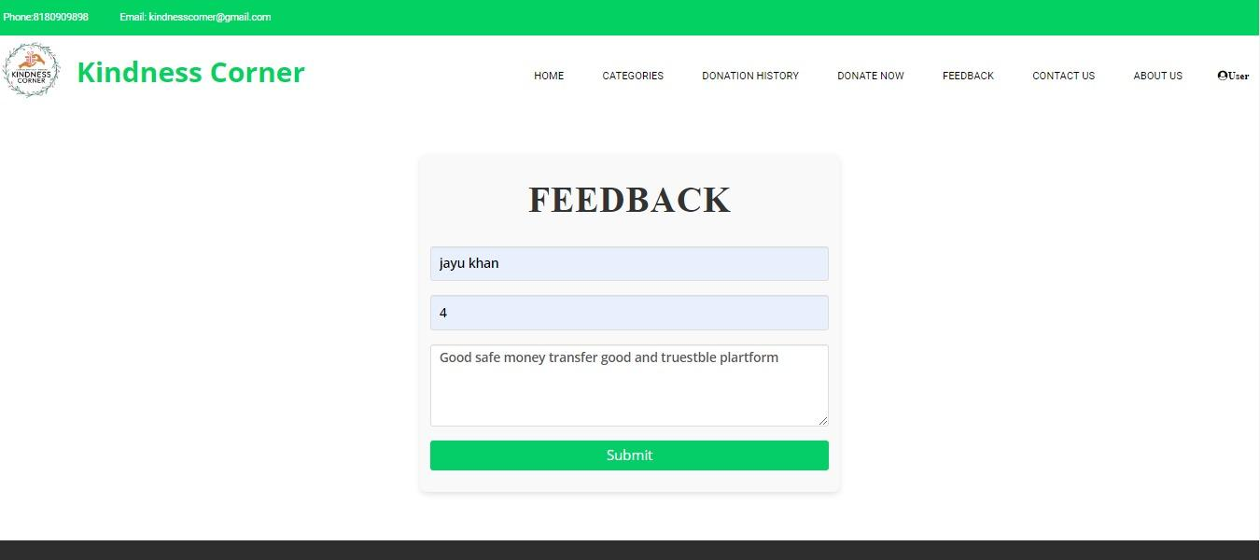
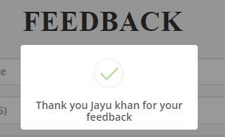
9. Give feedback

Slide 77


10. About us

Slide 78

11. Contact us

Slide 79

11. Contact us

Slide 80

11. Contact us

Slide 81

12. Change Password

Slide 82



13. Forgot Password

Slide 83

14. Logout

Slide 84
8. Screenshots
Receiver

Slide 85

1. Login

Slide 86

2. Sign up

Slide 87

3. Home page

Slide 88

4. Manage Profile (edit)

Slide 89

5. View categories

Slide 90

6. Request money

Slide 91

6. Request money

Slide 92

7. request history

Slide 93

8. Give feedback

Slide 94
9. About us

Slide 95
10. Contact us

Slide 96

10. Contact us

Slide 97

11. Change Password

Slide 98

11. Change Password

Slide 99

11. Change Password

Slide 100



12. Forgot Password

Slide 101
13. Logout

Slide 102
9. Reference
https://crowdfunding.milaap.org/
https://y4d.ngo/
https://thedesaifoundation.org/

Slide 103
Any Questions

Slide 104
Thank you so much

